Slide 1

DECENTRALIZED CROWDFUNDING PLATFORM
A Project Report
Submitted in Partial Fulfillment of the Requirement for the Award of the Degree of
BACHELOR OF TECHNOLOGY
(COMPUTER SCIENCE AND ENGINEERING)
To
Dr. A.P.J. ABDUL KALAM TECHNICAL UNIVERSITY
LUCKNOW
Submitted by
Snehil Gupta
University Roll No. 1801013074
Saumya Shukla
University Roll No. 1801013058
Under the Supervision of
Mr. Prashant Soni
Assistant Professor
DEPARTMENT OF COMPUTER SCIENCE & ENGINEERING
UNITED COLLEGE OF ENGINEERING AND RESEARCH, PRAYAGRAJ
June 2022

Slide 2
Introduction
Kickstarter’s idea :-
Kickstarter is an American crowdfunding platform, where creator can put up his idea and in return receive fund.
At first, the project creator will put up his idea on this application along with its requirements.
Upon liking the idea, the investors can fund the project in terms of cost and maintenance required for the project.
The project creator will choose a deadline and minimum funding goal.
If the goal is not met by the deadline, no fund are collected

Slide 3
Disadvantages of such idea :-
In case of kickstarter, the data is stored in a normal database which is mutable in nature.
So, some of the issues for this kind of service is that :-
People who post the project will deliver on their project or not.
The creator can even do some fraudulent activity such as running away with the fund.
Either the completed project will meet the funder’s expectations or not.
Notes:
hat the completed projects will meet backers' expectations.

Slide 4
Why we chose this topic
Our main aim for this project is to resolve this issue by helping the funders to avoid any kind of fraudulent risks that were mentioned before.
For this, we will use Ethereum blockchain in place of a normal database to make sure the application is immutable and tamper-free.
The fund will only be get transacted permanently only if the project is delivered to the investors properly.

Slide 5
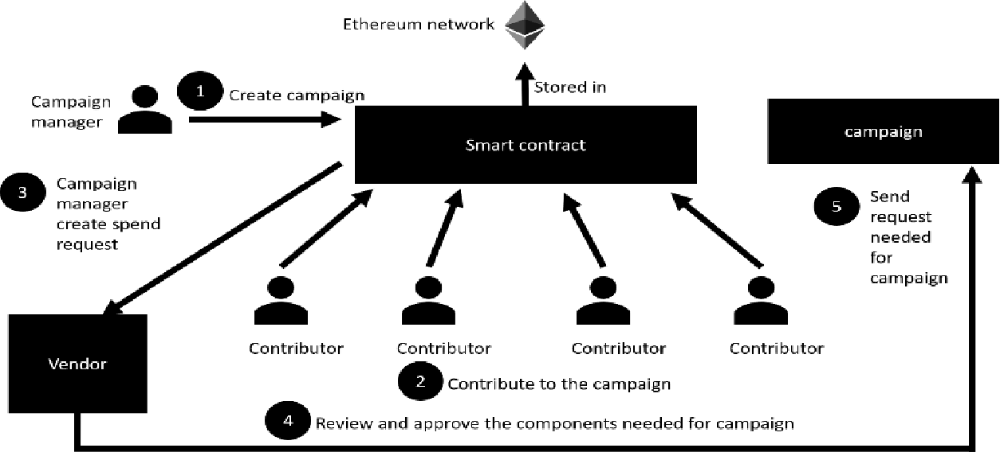
Project Overview

Slide 6
Software Requirements Specification
Category : Blockchain based Crowdfunding
Purpose : Crowdfunding platforms take a fee for every project listed. Sometimes, this is a flat fee while others require a percentage of the total proceeds raised by contributors. In some cases, startups turn up as scams and produce nothing leaving investors with empty hands and no way to get their money back. To avoid these fraudulent activities we will develop a decentralized crowdfunding platform using Blockchain.
Scope:
Use in Digital Advertising
Digital advertisers and brands are facing several challenges in the form of bot traffic, payment inefficiencies, lack of data transparency, etc. With some industry players indulging in malpractices to drive profits, it has become ever so important for others to take corrective measures. Decentralized verification can address issues in payments and fake traffic.

Slide 7
Implementation in Finance
Security, and transparency are two of the underlying features of Blockchain, With blockchain implementation, sectors like trade finance witnessed reduced processing time, eliminated paperwork, and became cost-efficient while maintaining security and trust.
Introduction
This project is a trusted and decentralized crowd funding platform which is implemented using blockchain as backend and react as front end. We chose this project because in today’s world there are lots of crowdfunding websites but what happens on those websites is that a person lets say Mr.X, he puts up his project idea and asks the investors to fund for his idea if they liked it. But what actually Mr.X does is, after the money is gathered for the project he withdraws that money, tamper the database of the site and then run away with the money. So, to prevent this fraudulent activity and the tampering of the database our project will be implemented using blockchain as backend since it is a tamper free technology.

Slide 8
Advantages :
Decentralization: Startups are not going to rely on any platform or combination of platforms to enable creators to raise funds. Startups no longer be beholden to the rules, regulations, and whims of the most popular crowdfunding platforms on the internet. This makes crowdfunding less expensive for creators and investors.
Smart Contracts: There are several ways in which blockchain-enabled smart contracts could provide greater accountability in crowdfunding. Primarily, these contracts would provide built-in milestones that would prevent funds from being released without provenance as to a project or campaign’s legitimacy.

Slide 9
Functional Requirements Of The System:
Must be accessible, in the broadest sense of the word
Must support user customization
Responsive in all the device
Show all the data of campaigns correctly
Must enable asynchronous communication and collaboration
Must enable synchronous collaboration and communication
Non-Functional requirements Of The System:
Security:
Secure all connections that contain cookie data
Client-side and server-side validation
Software updates

Slide 10
Maintenance:
Constant support and updates
24/7 Monitoring
Recommendations for site improvement
Software Tools:
UI/UX design : 1) Balsamiq wireframes
2) Adobe XD
Back-end :
1) Ethereum Blockchain
2) Solidity ( for creating smart contracts)
Front-end framework :
1) React
2) React Router
3) Next.js
Testing :
1) Mocha test framework
2) Ganache ( for local test network)
Deployment:
Ganache (Local Ethereum Test Network)

Slide 11
Objectives
To implement a decentralized application based on crowdfunding.
To use a front-end framework in order to interact with the application.
To allow the fund raisers to fund a project by sending ether to the e-wallet of the project creator.
To test the application before deploying it into the main ethereum blockchain network.
For future scope, we’ll add a functionality for investors to report the person if he attempts to fraud.

Slide 12
Major Modules
Module 1 : Information gathering / planning
Module 2 : UI/UX design
Module 3 : Content writing
Module 4 : Front-end design and development
Module 5 : Back-end / Blockchain Connectivity
Module 6 : Testing / Review

Slide 13
Responsibility Distribution
This project is divided among two people, the Front-end part is implemented and maintaining by Saumya Shukla in which we are using React technology, in this we divide our website into the components, which can be develop independently, so that our management will be good, also it helps in routing which gives a great user experience and our Back-end part is implemented and maintaining by Snehil Gupta, in which we are using blockchain rather than a normal database which prevent it from tampering, so this is how we are working over the trusted and safe transactions.

Slide 14
Future Plan
To make the interface more user friendly
Adding a description tag for every purchase that was made using the funding

Slide 15
Thank You

